Slide 1
Traffic Control Using Big Data
Presented by:
Sathvik - 351
Venkat - 365
Neha - 376
Biswanth - 380

Slide 2
Introduction
In a time where cities are becoming more and more crowded finding ways to manage traffic has become an issue. Our project focuses on utilizing data analysis to tackle this problem by examining traffic data and suggesting the best routes based on current conditions. The foundation of our project lies in a dataset obtained from Kaggle, which contains information, on vehicle counts at four junctions over a span of time. To enhance our analysis we divided the DateTime attribute into five attributes. Year, month, date, hour and day. Allowing us to gain insights into traffic patterns.

Slide 3
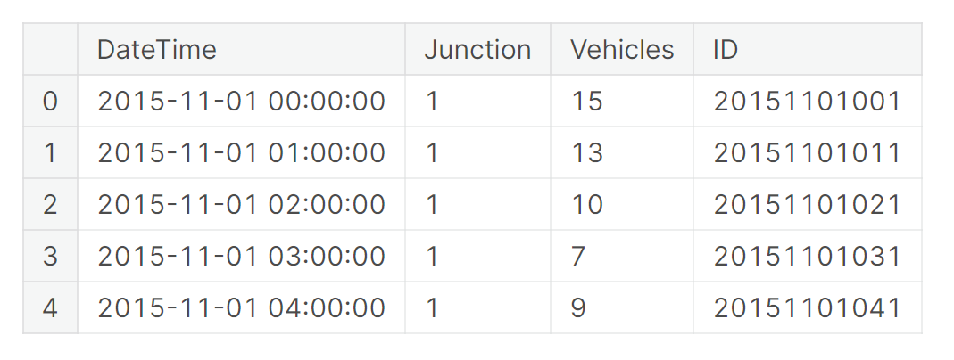
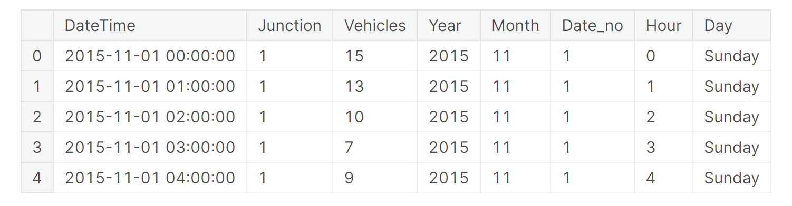
Initial Dataset
Final Dataset

Slide 4
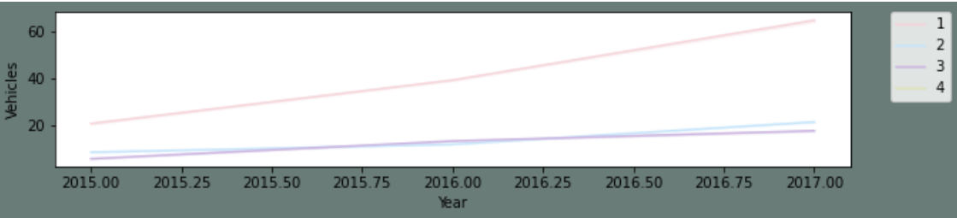
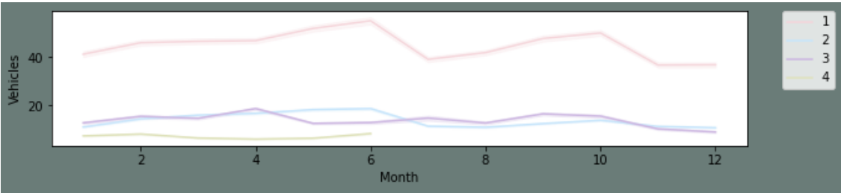
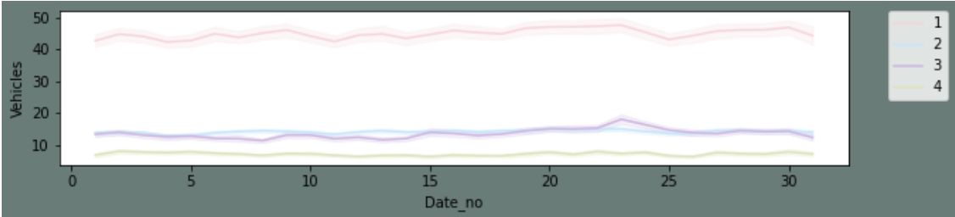
Line Plots:
Yearly, there has been an upward trend for all junctions except for the fourth junction. As we already established above that the fourth junction has limited data and that don't span over a year.
We can see that there is an influx in the first and second junctions around June. I presume this may be due to summer break and activities around the same.
Monthly, throughout all the dates there is a good consistency in data.

Slide 5
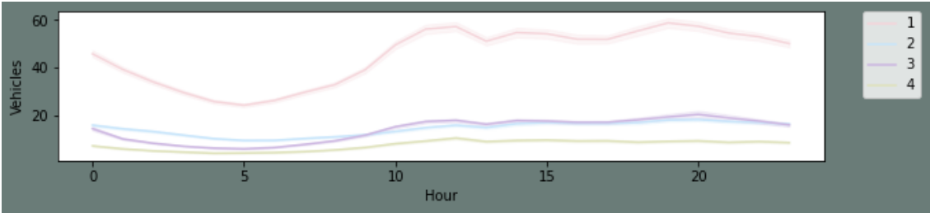
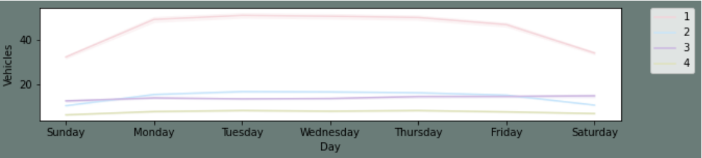
For a day, we can see that are peaks during morning and evening times and a decline during night hours.
This is as per expectation.
For weekly patterns, Sundays enjoy smoother traffic as there are lesser vehicles on roads. Whereas Monday to Friday the traffic is steady.

Slide 6
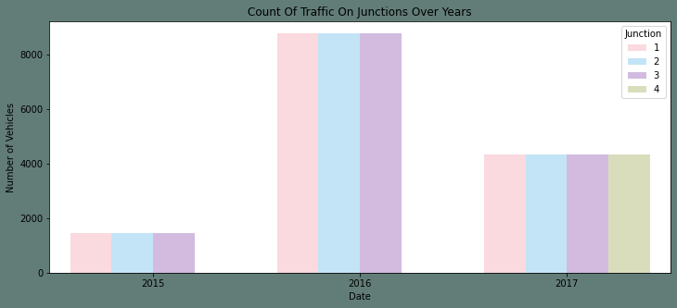
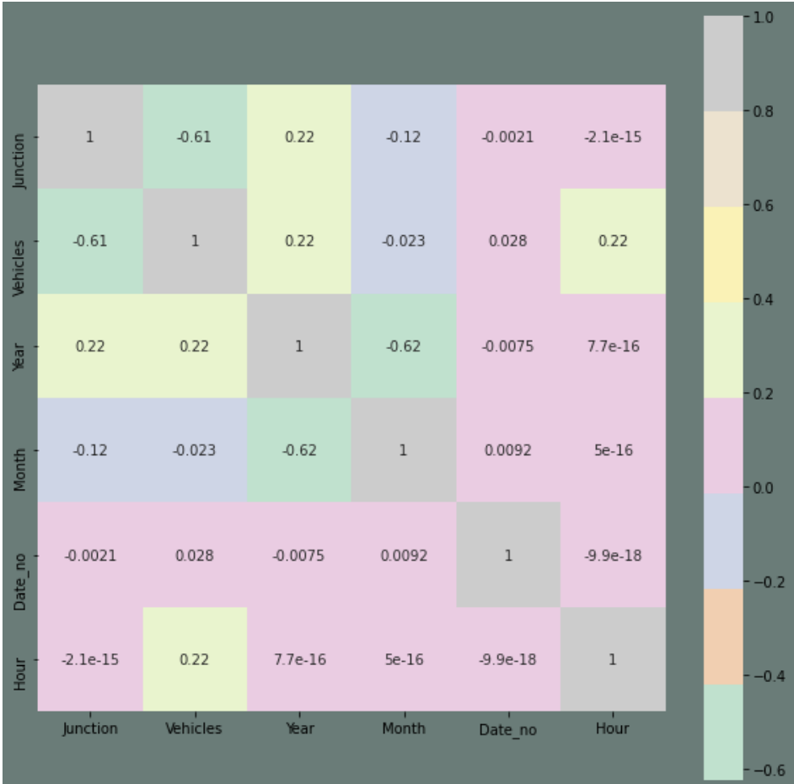
Count Plot:
The count plot shows that there is an increase in the
number of vehicles between 2015 and 2016.
However, it is inconclusive to say the same about 2017 as we
have limited data for 2017 ie till the 7th month.
Heat Map:
The highest correlation is certainly with the preexisting feature.
I will conclude my EDA with a pair plot. It's an interesting
overall representation of any data.

Slide 7
HADOOP HIVE:
Apache Hive is a data warehouse and an ETL tool which provides an SQL-like interface between the user and the Hadoop distributed file system (HDFS) which integrates Hadoop. It is built on top of Hadoop. It is a software project that provides data query and analysis. It facilitates reading, writing and handling wide datasets that stored in distributed storage and queried by Structure Query Language (SQL) syntax. It is not built for Online Transactional Processing (OLTP) workloads.
Apache Hive is a data warehouse software project that is built on top of the Hadoop ecosystem. It provides an SQL-like interface to query and analyze large datasets stored in Hadoop’s distributed file system (HDFS) or other compatible storage systems.
Hive uses a language called HiveQL, which is similar to SQL, to allow users to express data queries, transformations, and analyses in a familiar syntax. HiveQL statements are compiled into MapReduce jobs, which are then executed on the Hadoop cluster to process the data.

